Slide 1
CS 2600 Computer Networks I Dr. Sayeed Sajal Lecture 16 Link Utilization

Slide 2
Control Messages for Managing Retransmission
ACK (Acknowledgment)
Feedback from the receiver to the sender that says “I received the frame (or
frames) correctly”
Implies that the sender can discard the copy of the frame that it was holding for
possible retransmission
Cumulative ACK indicates that all prior frames were also received correctly
NAK (Negative Acknowledgment)
Feedback from the receiver to the sender that says “I received a frame with errors”
Or it may say “I know a frame is missing because I’ve already received subsequent
frames” (For example, “I got frames 1, 2 and 4, therefore frame 3 is missing”.)
NAK’s are problematic, not as widely used as ACKs

Slide 3
HDLC Supervisory Frame Operations

Slide 4
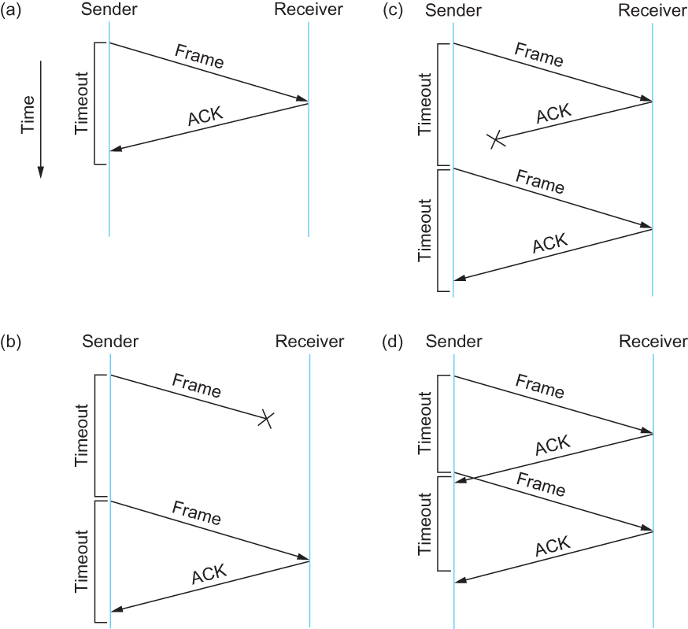
Figure 2.17 Timeline Showing Four Different Scenarios for the Stop-and-Wait Algorithm
Normal
Lost ACK
Lost Frame
Premature Timeout

Slide 5
The Fourth Principle of Network Design
“No undetected duplicate frames”

Slide 6
HDLC Frame Format

Slide 7
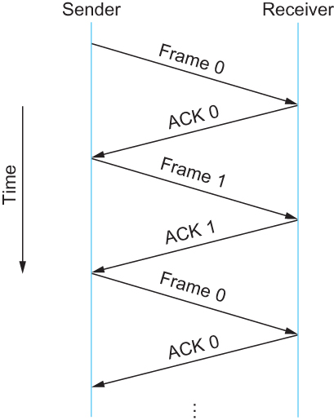
Figure 2.18 Timeline for Stop-and-Wait with 1-bit Sequence Number
RTT
Note that stop-and-wait is limited to transmitting a maximum of one frame per round trip time (RTT).
If the “volume of the pipe” is larger than the size of a typical frame, then stop-and-wait is potentially wasteful.

Slide 8
The Effect of Stop-and-Wait on Link Utilization (Based on text pp. 105 - 106)
Assume that we have a 1.5Mbps link with a 45ms RTT and 8KB frame size. If stop-and-wait ARQ is used, there will be some wasted “bandwidth” while we wait for the ACK. This wastes transmission capability, especially on expensive WAN links.
22.5ms
prop. delay
Stop here and wait for ACK
before sending Frame 2
Wasted capacity
Transmit frame 2 here (finally!)

Slide 9
The Problem with Stop-and-Wait
Conclusions so far:
1. In the previous scenario, the available data rate is 1.5Mbps, but we can’t do any better than about 730Kbps on a continuous basis (49% link utilization).
Calculation: 8KB/87.6ms = 64,000bits/.0876sec ≈ 730Kbps
2. If we could avoid having to wait for the ACK for each frame before transmitting the next, we should be able to do a better job of “filling the pipe”.

Slide 10
The Sliding Window Alternative to Stop-and-Wait
Here we have the same link running a sliding window instead of stop-and-wait (so we can transmit frames more-or-less continuously). So when the ACK for Frame 1 returns at t = 87.6ms, frames 1, 2 and the beginning 3 have been transmitted, yielding a data rate of 1.5Mbps. That should come as no surprise since that’s the data rate of the link, and we are transmitting frames continuously.

Slide 11
It’s Even Worse Than That!
Most Data-link level protocols use a smaller frame size, in the range of 53 to 2,272 bytes.
If a frame is a more typical size like 1KB, what happens to the utilization of a stop-and-wait link? For a frame with a transmission time less than the 22.5ms one-way propagation delay, the effective transmission rate is:
frame size = 1024 x 8 = 182Kbps
RTT 0.045
Read the calculation above as “if we use stop-and-wait, we can only send one 1KB frame per 45ms round trip.”
Comparing the effective rate of 182Kbps to the maximum possible continuous rate of 1.5Mbps, we get this utilization:
Effective rate = 0.182Mbps = 0.12 or 12% or approx. 1/8
Max rate 1.5Mbps

Slide 12
Conclusions About ARQ Systems
1. Using stop-and-wait ARQ with an 1KB frame size on this link yields an effective data transfer rate of about 12% or 1/8 of the maximum possible rate.
2. So, to “keep the pipe full” (utilize the link to its maximum efficiency), we should actually have about eight 1KB frames in the pipe at any given point in time.
3. If the RTT was shorter, fewer 1KB frames would be required to keep that (shorter) pipe full.
4. We want to get as close to maximum utilization as possible, because, if the cost of a link can be distributed across more frames, the per-frame cost is reduced.
5. We can add a new factor to our list of things which restrict data transmission over a link: the ARQ method. (Recall the other two factors were noise and bandwidth.)

Slide 13
What Characteristics Affect Stop-and-Wait?
All else being equal, a bigger pipe means lower efficiency with stop-and-wait
Longer distances and higher data rates make the pipe volume larger
Smaller messages also make stop-and-wait less efficient (since it takes more of them to fill the pipe)
On the other hand, stop-and-wait may fill the pipe nicely if these characteristics are present to a significant extent:
Large frame size
Low data rate (not so common in newer systems)
Low link propagation time (i.e., LANs)

Slide 14
The Effect of a on Link Utilization
The a value of a link is the ratio of propagation time to transmission time. Stop-and-wait is reasonably efficient when a < 1, in other words, when it takes longer to transmit the message out of the adapter than it does for the front of the message to cross the link (as shown in the right hand example above.) In that case, one frame fills the pipe and there’s little or no benefit to transmitting multiple frames prior to receiving the first ACK.

Slide 15
The Fifth Principle of Network Design
“In general, stop-and-wait ARQ works better on LANs than it does on WANs – but there are exceptions.”

Slide 16
Homework Question 23.
Consider an ARQ algorithm running over a 40-km point-to-point fiber optic link. (10 points)
(a) Compute the propagation delay for this link, assuming that the speed of light is 2 x 10⁸ meters per second in the fiber.
(b) Suggest a suitable timeout value for the ARQ algorithm to use. (Assume that transmission time for data frames and returning ACKs is insignificant, compared to link propagation delay.)
(c) Why might it still be possible for the ARQ algorithm to time out and retransmit a frame, given this timeout value?

